Slide 1

SEND Coffee Morning

Slide 2
What is SEND?
SEND - Special Educational Needs and Disabilities
“A child or young person has SEN if they have a learning difficulty or disability which calls for special educational provision to be made for him or her.”
“A ‘Learning Difficultly’ is where a child: Has significantly greater difficulty in learning than the majority of the children of the same age or has a disability which prevents or hinders them from making use of facilities provided.”
SEND Code of Practice 2015

Slide 3
There are four broad areas of need within SEND:
Cognition and Learning Needs
Communication and Interaction Needs
Social, Emotional and Mental Health Needs
(SEMH)
Sensory and/ or Physical Needs

Slide 4
What is SEND provision?
‘Special Educational Provision’ means educational support which is additional to or different from that which is made generally for children in schools.
Curriculum adaptations and differentiation
Specific teaching interventions
Equipment and resourcing
Individual support
Advice from specialists
Emotional and social support
All matched to individual need!

Slide 5
SEND IDENTIFICATION AND SUPPORT IN SCHOOL
Assessment/Observations
Discussion with parents/carers/pupil
Professional Advice/ Involvement
Support plan (APDR)
HNBF/EHCP

Slide 6
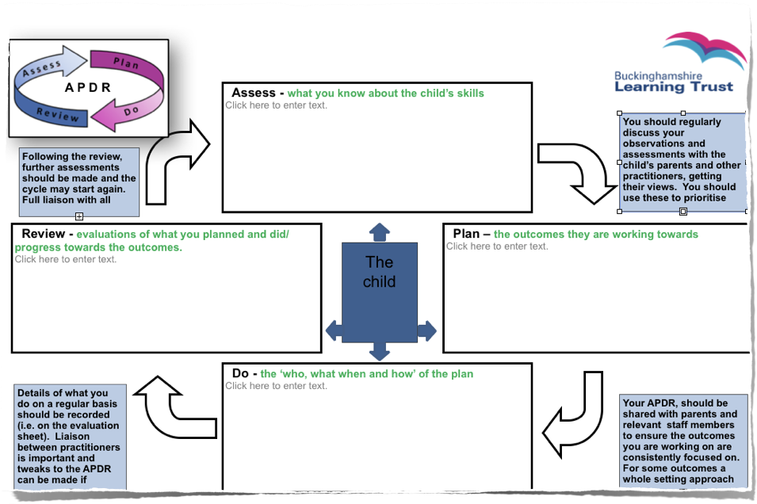

Slide 7

Example Activities/Interventions
Brain training
Developing language
Fine motor skills
Reading

Slide 8
Useful Websites:
Buckinghamshire Family Information Services:
SEND
https://familyinfo.buckinghamshire.gov.uk/send/
CAMHS
https://www.oxfordhealth.nhs.uk/camhs/self-care/
Every Mind Matters
https://www.nhs.uk/every-mind-matters/
Mind
https://www.mind.org.uk/
SLT-Children's Speech & Language Therapy in Buckinghamshire
https://slt.buckshealth.link/
Occupational Therapy (OT)
https://www.buckshealthcare.nhs.uk/cyp/therapy/occupational-therapy/occupational-therapy-resources/
School SEND Webpage

Slide 9

Any questions…..

