Slide 1
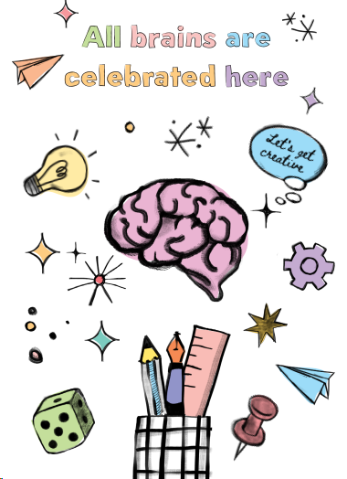
Autism and ADHD
SEND Coffee Session
18th March 2024

Slide 2
Aims:
To increase knowledge and understanding of Autism (ASD/ASC) and ADHD
To find out how children with Autism and ADHD are supported at Radnage school
To take away some useful strategies to support children presenting with ASC and/or ADHD behaviours/traits.

Slide 3
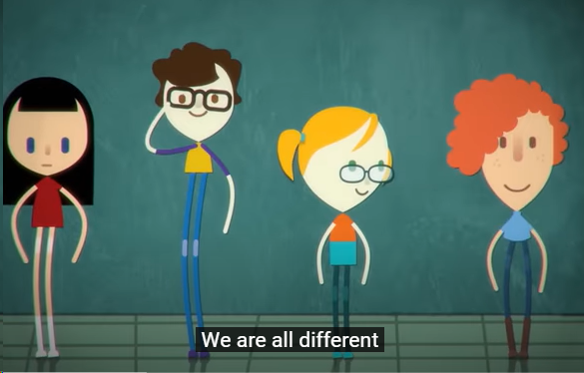
What is Autism?
https://www.youtube.com/watch?v=Ezv85LMFx2E

Slide 4
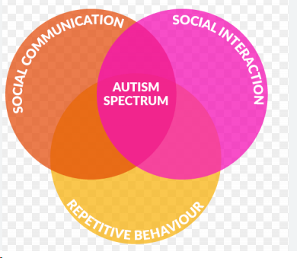
What is Autism?
Autism is a lifelong condition which can affect social and communication skills. As Autism is a spectrum condition, every Autistic person is affected differently.
Autistic people can have differences with:
-Social Communication and Interaction
-Restricted, repetitive patterns of behaviour, intense interests, or activities
and Sensory preference and sensitivities (Dyad of impairments)
The causes of autism are still being looked into. Many experts believe that there isn't one specific 'cause', and that there are genetic factors. National Autistic Society (NAS) 2024
Triad of impairments has been replaced with Dyad of impairments
Some Autistic children may find it difficult to perceive the world around them. Some may find it hard to read or understand the emotions of others.
Anxiety affects a lot of autistic children and adults. It can be caused by not being able to make sense of things going on around them, change of routine and feeling misunderstood- May result in behaviours such as metldowns/stimming

Slide 5
What is Autism?
Some Autistic children have excellent memories - they can remember facts, be very precise with detail and can follow schedules and routines. However, this is not the same for everyone on the Autism Spectrum.
Autistic people may learn a lot about a topic they like, which could be anything!
Autistic people may compartmentalise things/people/situations
Most Autistic children go to mainstream school, while others require support at special schools.

Slide 6
Autism and girls
In the past, it was assumed that autistic people were overwhelmingly men and boys, and only very rarely women and girls. This is wrong!
Autistic characteristics in women and girls may differ from those of other autistic people because:
They might seem to have fewer social difficulties than autistic men and boys, but this could be because they are more likely to 'mask' their autistic traits (though the stress of doing so can result in anxiety and overwhelm).
At school, autistic girls may be more likely to be part of a friendship group and this could be a reason that teachers don't notice their differences.
They may also be missed if their academic achievement masks difficulties they are facing in other areas.

Slide 7
Autism and girls
Some of the core characteristics of autism are having ‘repetitive behaviours’ (also known as stimming or self-stimulating behaviours) and highly-focused interests.
Stereotyped examples of these include rocking backwards and forwards, and a fascination with trains.
However, in autistic women and girls these behaviours and interests may be similar to those of non-autistic women and girls, such as twirling hair and reading books, and as such may go unnoticed despite the greater intensity or focus typical for autistic people.
National Autistic Society 2024

Slide 8
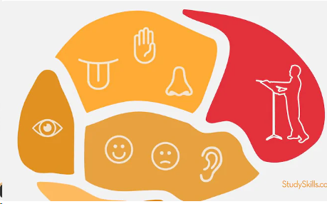
What is ADHD?
Video:
https://www.youtube.com/watch?v=suEjXwnxaYY

Slide 9
What is ADHD?
ADHD stands for Attention Deficit Hyperactivity Disorder. ADD stands for Attention Deficit Disorder.
ADHD is often picked up when children are young and are struggling to:
pay attention
stay focused or concentrate
sit still without fidgeting or becoming restless (hyperactivity)
think before they do things (Impulsive)
Many of us go through phases where we are fidgety or find it hard to pay attention. This can be completely normal and does not mean you have ADHD.
Things normally get better as children get older, but some adults are affected all their lives. ADHD affects more boys than girls.
CAMHS-Oxford Health 2024

Slide 10
How are Autism and ADHD connected?
More than half of all individuals who have been diagnosed with ASD also have signs of ADHD. In fact, ADHD is the most common coexisting condition in children with ASD. On the flip side, up to a quarter of children with ADHD have low-level signs of ASD, which might include having difficulty with social skills or being very sensitive to clothing textures, for example.
Both ADHD and ASD are neurodevelopmental disorders (brain development has been affected in some way). That means both conditions/differences affect the central nervous system, which is responsible for movement, language, memory, and social and focusing skills.
Most importantly, the conditions affect the brain’s executive functioning, which is responsible for decision making, impulse control, time management, focus, and organization skills.
ADHD and Autism Spectrum Disorder:
https://chadd.org/about-adhd/adhd-and-autism-spectrum-disorder/

Slide 11
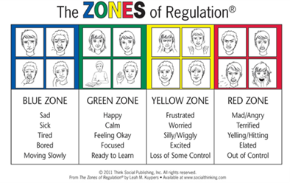
How are neurodivergent children supported at Radnage School?
Visual resources/timetables to support organisation/transitions/independence and to reduce anxiety.
Teaching Emotional Regulation- Zones of Regulation
Movement/sensory breaks (calm space/Calm corner outside)
Sensory Toys/Resources- Ear defenders/fidget toys
Social Stories- Preparing for new/unfamiliar/difficult situations
Comic Strip Conversations- to support with undesired behaviours
Alternative forms of communication- Makaton signing/Communication board/ PODD book.
Group/1:1 interventions depending on a child’s need: Nurture sessions/Lego Therapy/sensory activities

Slide 12
How Parents/and Carers can support children at home?
Give simple instructions.
Set clear boundaries.
Involve the family.
Build healthy routines-give plenty of notice of any foreseen changes.
Help with organisation-Checklists/visuals/zones
Manage triggers- keep a log.
Give LOTS of praise!

Slide 13
How Parents/and Carers can support children at home?
How to help your child communicate
use your child's name so they know you're speaking to them
keep language simple and clear
speak slowly and clearly
use simple gestures, eye contact and pictures or symbols to support what you're saying
allow extra time for your child to understand what you have said.
Dealing with anxiety
Try to find out why your child's feeling anxious.
It might be because of:
a change in routine – it might help to prepare your child for any change; change of class, school trip (Social Stories)
a noisy or brightly coloured place – it might help to take your child to a calmer place,
difficulty identifying, understanding or managing their feelings (Zones of Regulation)

Slide 14
Eating difficulties It’s important for all children to eat a healthy balanced diet, however often children with ASD/ADHD can be "fussy eaters“ due to their sensory differences. They may:
How Parents/and Carers can support children at home?
only want to eat foods of a certain colour or texture
not eat enough or eat too much
eat things which are not food (called pica)
have problems with coughing or choking while eating
be constipated, so they feel full even when they have not eaten much food
It may help to keep a food diary, including what, where and when your child eats. This can help you notice any common issues your child has.
Speak to a GP about any problems your child's having with eating. The National Autistic Society has more about how to help with eating problems

Slide 15
Friendships and socialising:
Try not to force your child into social situations if they're OK being on their own.
Speak to your child's Class Teacher/SENDCo
Read more advice about making friends from the National Autistic Society
Try not to put pressure on your child – learning social skills takes time
How Parents/and Carers can support children at home?

Slide 16
Staying healthy It's important that your child has regular check-ups with the: dentist optician doctors treating any other conditions your child has
How Parents/and Carers can support children at home?
Difficulty Sleeping:
This may be because of:
anxiety
sensitivity to the light from smartphones or tablets
problems with the sleep hormone melatonin
issues such as hyperactivity or a health condition that affects sleep
You can help your child by:
keeping a sleep diary of how your child sleeps to help you notice any common issues
following the same bedtime routine
making sure their bedroom is dark and quiet
letting them wear ear plugs if it helps
talking to a GP about how to manage health conditions that make sleep difficult, such as a food sensitivity or breathing problem

Slide 17
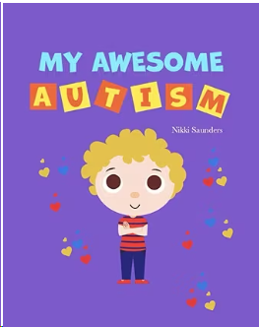
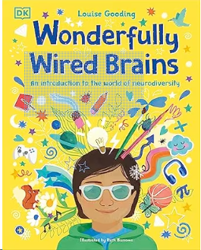
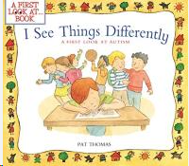
Useful Books:

Slide 18
Useful websites:
https://www.autism.org.uk/
https://www.oxfordhealth.nhs.uk/camhs/self-care/
https://www.nhs.uk/conditions/autism/
https://www.adhdfoundation.org.uk/

