Slide 1
Education Health & Care Plans (EHCP) Application process
SEND Coffee Session
Tuesday 21st May 2024 2:00-3:00

Slide 2
Education, Health and Care Plan
What is it?
An Education, Health and Care Plan or EHCP is a legal document that describes a child or young person’s special educational needs and/or disabilities (SEND). An EHCP is written and provided by a local authority (LA) in order to give children and young people the help and support they need in order to make progress academically, socially and emotionally.

Slide 3
Education, Health and Care Plan
When is an EHCP required?
An EHCP is required when a child’s needs cannot be met by the usual support that is available to them in their school or setting. It should provide support until the age of 25 - not only while they are in education.
Who writes an EHCP?
An EHCP should include the views of the child or young person, their parents/ carers, any professionals involved, the class teacher and the SENDCo of the school.
As a parent, you will be asked to complete your views and feelings about your child’s academic, social and emotional development. It is important to be open and honest so that the best possible support can be arranged. Your child’s school or setting will be asked to complete a report about your child’s needs, support and progress, which will then be submitted to the local authority.

Slide 4
Education, Health and Care Plan
An EHC plan does not guarantee extra funding. It is also important to note that different local authorities may have different ways of banding or allocating funding/resources.

Slide 5
The Process: What happens?
Starting the process:
For the process of getting an EHCP to begin, an EHC Needs Assessment needs to take place.
You can ask your local authority to carry out an EHC Needs Assessment if you think your child needs an EHCP.
The SENDCo at your child’s school can request an EHC Needs Assessment if they (or you) feel it is necessary.
If a young person is aged 16 to 25, they can request an assessment themselves.
A request might also be made by anyone else who thinks an assessment might be needed, such as your child’s teacher, doctor, a member of your family, a friend or another health professional.
An EHC Needs Assessment does not guarantee an EHC Plan.
EHC Needs Assessments are requested via a standard process - an Education, Health and Care Needs Assessment Request (EHCNA).

Slide 6
EHC Needs Assessment
How long does the assessment take?
Anyone supplying information towards the assessment has 6 weeks to submit it to the local authority (LA).
The Local Authority (LA) will inform parents, carers, or young people whether or not an EHC assessment will be carried out by week 6.
One result of the assessment may be that the LA do not think an EHC plan is necessary to support a child or young person.
The LA will inform parents, carers, or young people within 16 weeks of getting the original request if this is the case.

Slide 7
EHC Needs Assessment
If your local authority decides an EHCP is needed, they must:
inform you and your child of their decision and give reasons
make sure a plan is prepared
give you and your child 15 days to look at a draft plan, provide your views and have the chance to ask for a particular school or education provider to be named on the plan
issue a final plan within 20 weeks of the request for an EHC Needs Assessment

Slide 8
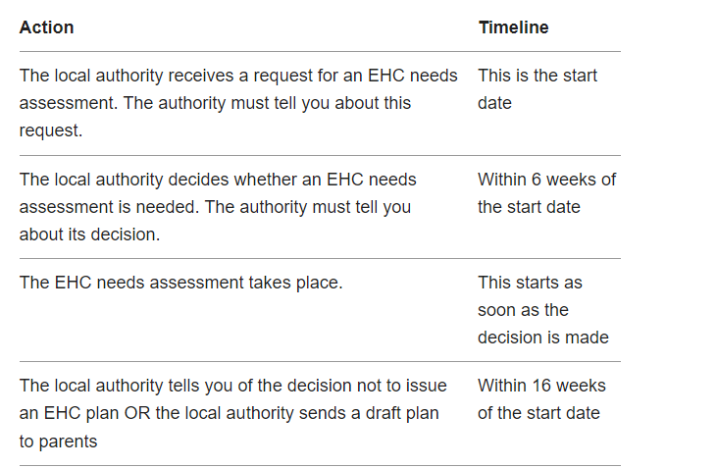
The process:

Slide 9
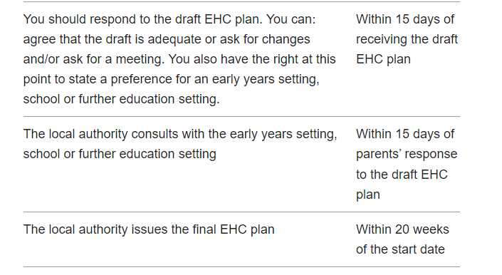
The Process

Slide 10
The Process-Timeline

Slide 11
The Process
Some of the reasons the 20-week deadline may be extended:
Appointments with people the local authority requested information from might have been missed by you or your child.
If your child is absent from the area for a period of at least four weeks, this could result in an extended deadline.
It may be that exceptional personal circumstances affect you or your child.
The deadline could be extended if the educational setting is closed for at least four weeks. This may delay the submission of information from the setting.
If you notice that this deadline has been missed, contact your school SENDCo or local authority.

Slide 12
The right to appeal
During the EHCP process, you have the right to apply for a decision to be reversed at certain points. You can appeal if you do not agree with the EHCP your local authority has made, or if they:
refuse to carry out an EHC Needs Assessment or reassessment
refuse to create an EHCP after carrying out an assessment or reassessment
refuse to change the sections of an existing EHCP which are about education (sections B, F and I)
decide your child does not need an EHCP any more

Slide 13
Useful links and support
The SEND local offer provides useful information for children and young people with Special Educational Needs and Disabilities (SEND) and their families: https://familyinfo.buckinghamshire.gov.uk/send/
SENDIASS is an impartial and confidential service offering advice for parents and carers. Each area has its own SENDIASS; you can find your local service:#
https://www.buckinghamshire.gov.uk/schools-and-learning/bucks-sendias-service/contact-sendias/
Independent Provider of Special Education Advice www.ipsea.org.uk
National Children’s Bureau www.iassnetwork.org.uk
Council for Disabled Children www.councilfordisabledchildren.org.uk
NSPCC - supporting children with SEND
https://learning.nspcc.org.uk/safeguarding-child-protection/children-who-have-send-asn-aln
Family Action - SEND information for parents and carers:
https://www.family-action.org.uk/what-we-do/children-families/send/
Twinkl Parents SEND Facebook group
Legislation and Related Government Guidance
SEN Regulation 2014
SEN Code of Practice (2015)
SEND Guide for Parents and Carers

